Slide 1
REFINING PROCESS FOR CRUDE OIL

Slide 2
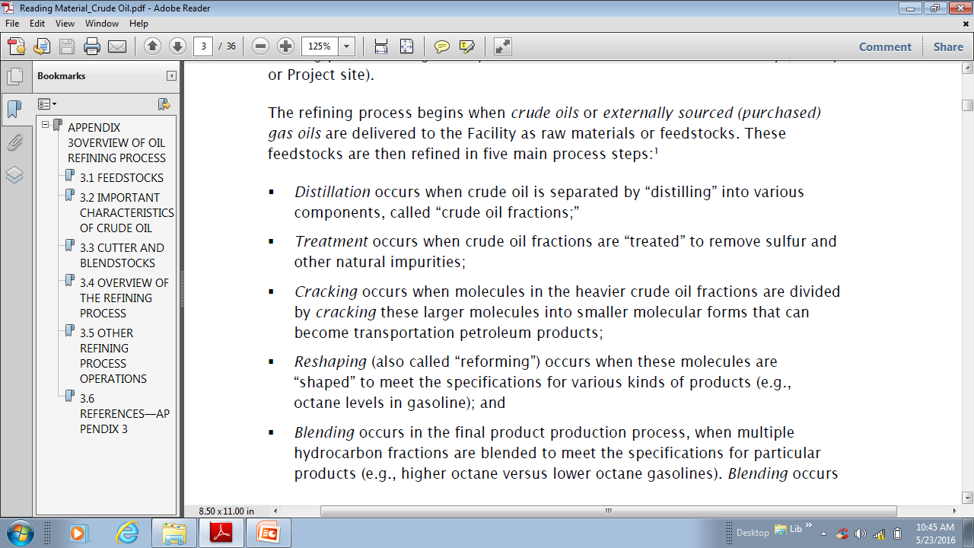

Slide 3
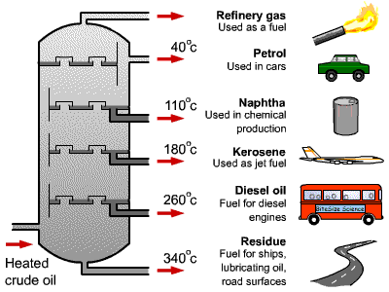

Slide 4
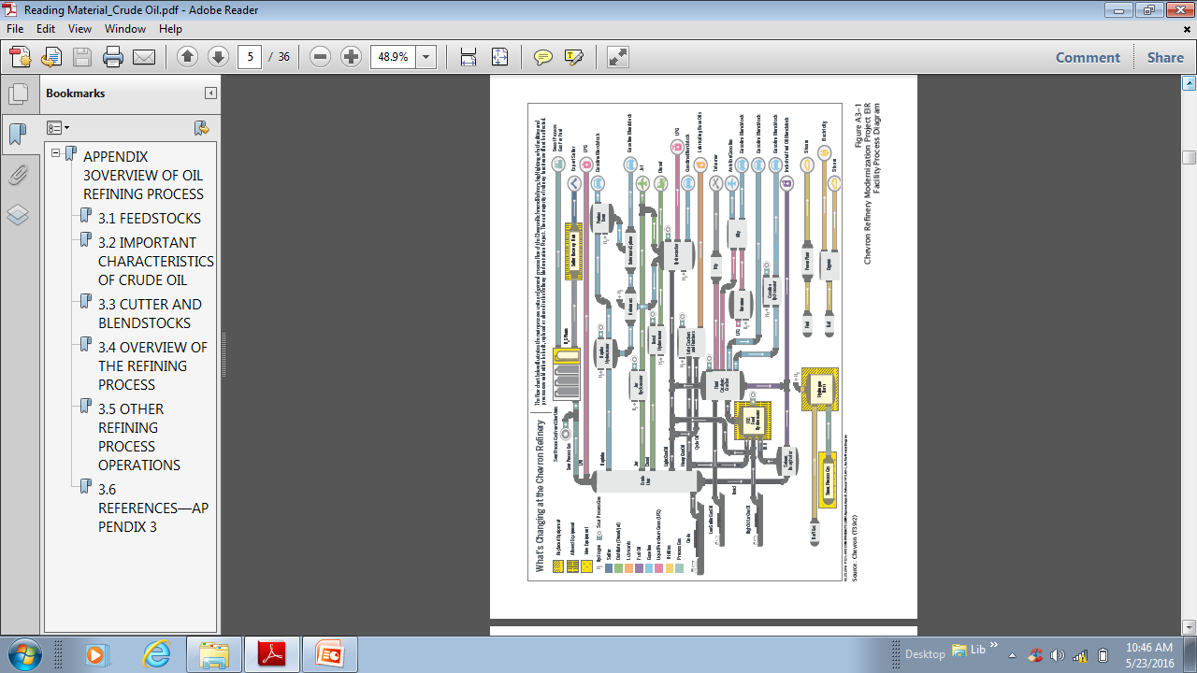

Slide 5
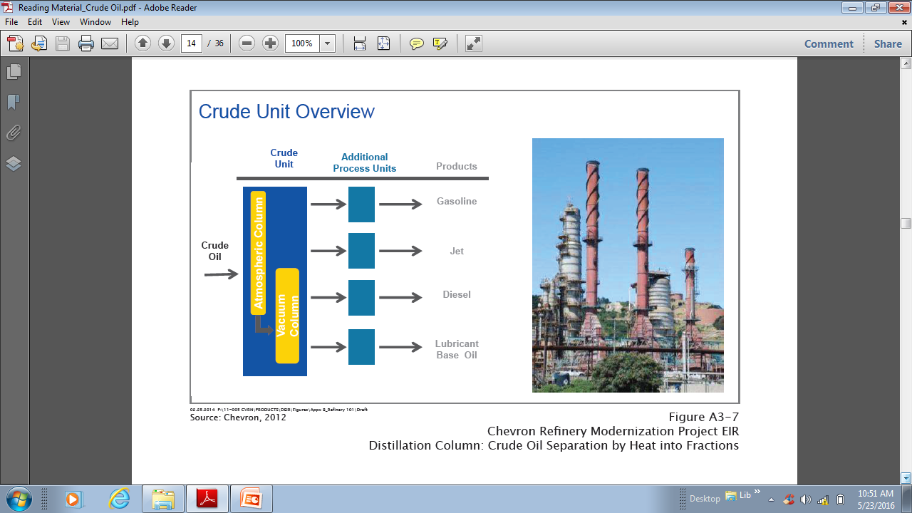

Slide 6
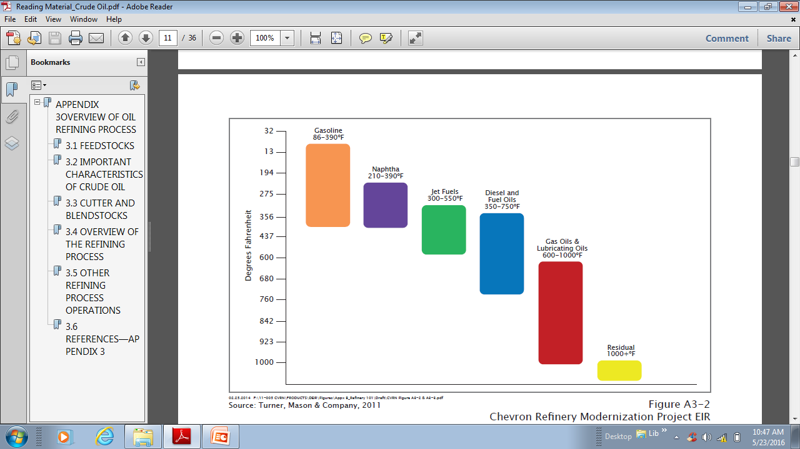

Slide 7
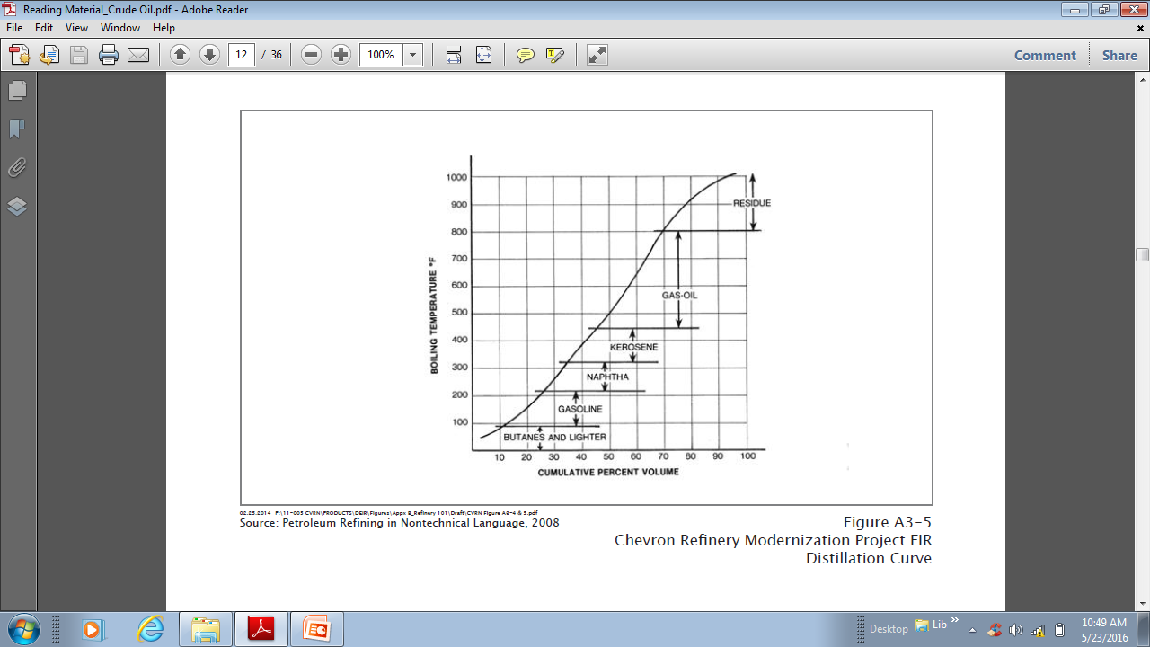

Slide 8
The yield and boiling range of a typical crude oil in primary or straight run distillation is given below:
Distillate | Boiling range (degree Celsius) | Yield (%)
Light gasoline including gases | - | 8
Heavy gasoline | 30-65 | 12
naphtha | 65-250 | 5
Kerosene | 150-250 | 15
Gas oil | 150-400 | 5
Residue | 320-540 | 55

Slide 9
Properties of Gasoline And Diesel

Slide 10
Gasoline
Gasoline , is a transparent, petroleum-derived liquid that is used primarily as a fuel in internal
combustion engines.
It consists mostly of organic compounds obtained by the fractional distillation of petroleum,
enhanced with a variety of additives.
Gasoline is an ideal fuel for spark ignition engines.
The main advantage of gasoline is it’s light weight per power developed.
The desired properties of gasoline are:
Low boiling point
High octane rate
Less impurities

Slide 11
High octane rate
Increasing the pressure of the fuel mixture in the combustion chamber before ignition helps to increase power of an engine.
This is done by compressing the fuel mixture to a smaller volume. Higher compression ratios not only boost power but also make for more efficient power. But as the compression ratio goes up, knocking tendency increases and the anti-knock value of the fuel becomes critical.
The octane number of a gasoline is a measure of its anti-knock quality to resist detonation during combustion. Detonation, sometimes can be defined as an uncontrolled explosion of the last portion in the combustion chamber. Since detonation creates shock pressure waves, it results in loss of power, excessive localized temperatures, and engine damage if sufficiently severe.
Thus, gasoline should have high octane number, which could be done by adding Tetra ethyl lead(TEL).

Slide 12
Low boiling point
The temperature at which the first 10% of gasoline evaporates is a measure of the ease of starting.
The normal boiling range of motor gasoline is 30 to 300 degree Celsius.
At 70 degree Celsius a minimum of 10% of gasoline by volume should evaporate.
It is necessary to have a low boiling point of gasoline because the vapor burns easily and more efficiently than liquid droplets.

Slide 13
Impurities
The gasoline should not contain a large amount of impurities such as gum, carbon, sulphur and water.
The presences of gum causes valve sticking and heavy intake deposits.
Sulphur forms acidic compounds in the engine and exhaust.
Sulphur also inhibits the action of tetra ethyl lead.
So, efforts must be made to remove impurities.

Slide 14
Diesel
Diesel fuel produces power in an engine when it is atomized and mixed with air in the combustion chamber.
Pressure caused by the piston rising in the cylinder causes a rapid temperature increase.
When fuel is injected, the fuel/air mixture ignites and the energy of the diesel fuel is released forcing the piston downwards and turning the crankshaft.
The chief requirements of diesel fuels are:
High cetane number
Fairly high flash point
Thermal stability

Slide 15
Cetane number
Cetane number is a measure of the ignition delay of a diesel fuel. The shorter the interval between the time the fuel is injected and the time it begins to burn, the higher is its cetane number.
It is a measure of the ease with which the fuel can be ignited and is most significant in low temperature starting.
The importance of cetane number is very evident as low cetane number usually causes an ignition delay in the engine.
This delay causes starting difficulties and engine knock. Ignition delay also causes poor fuel economy, a loss of power and sometimes engine damage.
So, diesel should have high cetane number.

Slide 16
Flash point
Flash point is determined by heating the fuel in a small enclosed chamber until the vapors ignite when a small flame is passed over the surface of the liquid.
The temperature of the fuel at this point is the flash point.
It provide a useful check on suspected contaminants such as gasoline, since as little as 0.5% of gasoline present can lower the flash point of the fuel very markedly.

Slide 17
Thermal stability
Heat transfer is a design function of diesel fuels in many modern diesel engines.
Only a portion of the fuel that is circulated and pressurized by the fuel injection system is actually combusted.
The remainder of the fuel is recycled back to the fuel tank. The bulk fuel temperature can be well above ambient levels.
High-temperature stability of a diesel fuel can result in the formation of insoluble degradation products that can then cause filter plugging.
In colder temperatures, the recycling of heated fuel back to a colder fuel tank, can cause condensation problems, that could lead to increase in free moisture in the fuel. This problem could possibly lead to filter plugging.
So, it must be thermally stable.

